Slide 1
Humans in the Wild
How to Hack Humans on the Fly
Adrigon Moroi, M.A.Ed
ShellCon 2019

Slide 2
“On the fly?”
“psychological based social engineering” (Charles Lively)
Humans are volatile
Chaos theory
Situations come up

Slide 3
Humans, amirite?
Complex
Hard to read
Unpredictable
Sensitive
The weakest point in any system
Programmatic
Easy to classify
Statistically uninteresting
Vulnerable
The most exploitable point in any system

Slide 4
Situations
In Security…
OS-Int → More information
Attacks → Stronger, more productive
Spot checks → Remove complacency
In Civilian…
At the store…
At college…
At church…

Slide 5
Mantra of Social Engineering
“Be professional, be calm, know your mark” (Chirillo)
BUT…no time! What do?!

Slide 6
Toolkit
WIS
CHA
INT
Privilege
Knowledge of system
Psychology
Evolutionary
Social
Developmental
Fashion
Logic
Social politics
Everything Else!
Varied Interests
Contextual knowledge
Every book ever

Slide 7
Trust the Process
Problem:
Goal:
OS-Int:
Formulate:
Attack:
Record/Report:
Exercise: Build Thesis
For each of the following hypotheticals, decide:
What are the Problems in each situation?
What are the Goals in each situation?
At the store… In college… In the field….

Slide 8
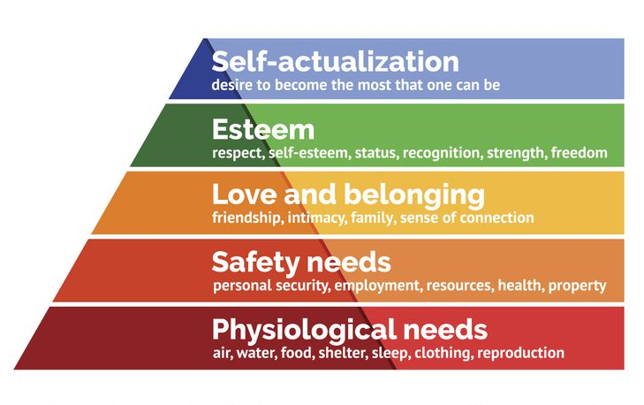
OS-Int: Assess
Maslow’s hierarchy of needs
Privilege/power dynamic
Setting
Situation
Emotion

Slide 9
Formulate Attack: Choose Persuasion Method
Reciprocity → Helpful Vector
Scarcity → Fear Vector (FOMO)
Authority → All Vectors
Consistency → Comfort Zone Vector (seeding/priming)
Liking → Helpful, Dis/Comfort Zone Vectors
Consensus → Dis/Comfort Zone Vector

Slide 10
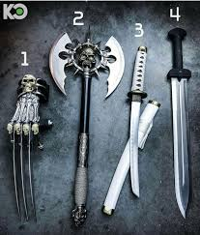
Formulate Attack: Choose Attack Vector
Informed by persuasion method
Careless//Simple
Dis/Comfort Zone//Familiar
Peer/social pressure
Helpful//Assistive
AVOID: Fear//Emotional
unless you’re really sure about your privilege calculus.

Slide 11
Comfort Zone Vector
Must create to exploit
Liking (Cialdani)
Eye contact
Smiling
Good humor
Relaxed posture
Common ground
Humanise
Authoritative (Cialdani)
Non-challenging power stance
Clear, strong voice
Committed to statements
Even tone

Slide 12
Discomfort Zone Vector
Consensus (Cialdani)
Disrupt comfort
Peer pressure
Non-confrontational
Moral high ground
Exploit setting, turn against undesirable behavior
Remove self from complacent narrative

Slide 13
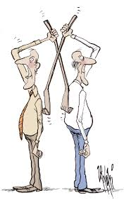
Helpful Vector
People want to be helpful/assistive. Why?
Evolutionary psych
Reciprocity (Cialdani)
At the hackerspace…
In social work…
At the post office….

Slide 14
1:1: At the Store…
Man is berating female clerk, yelling at her to honor his expired coupon
Problem:
For clerk
For observers
Goal:
For clerk
For observers

Slide 15
1:1: At the store… (con’t)
OS-Int
Clerk
Man
Self
Onlookers
Setting/Context
Privilege calculus
Legality
Formulate
Careless?
Comfort Zone?
Helpful?
Fear?
Discomfort Zone/Peer Pressure
Attack
Record/Report

Slide 16
Group hacks: At college…
Problem(s):
Goal(s):
OS-Int:
Formulate:
Attack:
Record/Report:

Slide 17
In the field…
OS-Int
Problem:
Goal:
OS-Int:
Formulate:
Attack:
Record/Report:
Attacks
Problem:
Goal:
OS-Int:
Formulate:
Attack:
Record/Report:
Spot checks
Problem:
Goal:
OS-Int:
Formulate:
Attack:
Record/Report:

Slide 18
Conclusion
How people present can serve as OS-Int
People will do more than they think they will
People will say more than they think they will
Elicit the right narrative and emotion by using most appropriate vector
Use procedure outline to take best advantage of situation

Slide 19
Sources
Chirillo, John. "Hack Attacks Denied" A Complete Guide to Network Lockdowns for UNIX, Windows, and Linux, Second Edition". Second Edition". John Wiley & Sons, Inc. 2002.
Cialdini, R. B. (2007). Influence: The psychology of persuasion
Hadnagy, Christopher. Social Engineering: the Science of Human Hacking. Wiley, 2018.
Lively, Charles. “Psychological Based Social Engineering.” Global Information Assurance Certification, SANS Institute, December 2003, www.giac.org/paper/gsec/3547/psychological-based-social-engineering/105780
Maslow, A. H. (1943). A theory of human motivation. Psychological Review, 50(4), 370-396. http://dx.doi.org/10.1037/h0054346
Tyler, Michael. “Brain-Hacking: Why Social Engineering Is so Effective.” Security Boulevard, 19 Feb. 2019, securityboulevard.com/2019/02/brain-hacking-why-social-engineering-is-so-effective/.

Slide 20
The End
Now go forth and fuck with people
@rigmoroi

