Slide 1
Don’t Run with Scissors: How to standardize how developers use dangerous aspects of your framework
Morgan Roman

Slide 2
About Me
Currently work on the application security team at DocuSign
Special thanks to Hailey Dhanens, John Heasman, Krishna Rai, Rui Tu, Josh Estalilla, and Skyler Berg
We were tired of playing whack-a-mole with bugs
Note: My examples may use one particular library or framework, but this strategy is independent of any framework/language/library.
Notes:
DocuSign is a esignature platform. I was an SDET. I wrote web and api tests. I would help out the security team by creating regression tests for them occasionally. DocuSign has an amazing set of integration tests.

Slide 3
Validation
Logging
The secure way
The secure way is not the easy way!
A
The easy way
B
Encoding
The problem

Slide 4
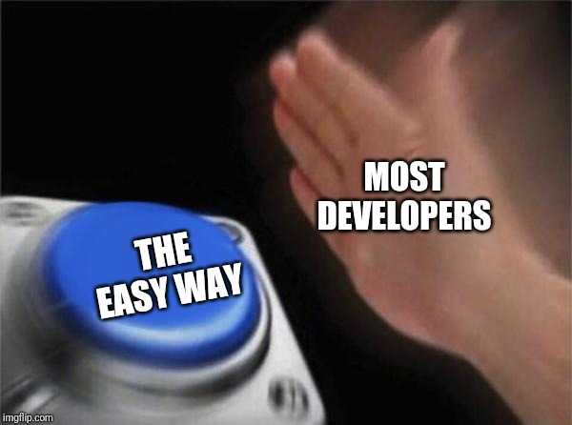
A
Make the easy way the secure way
B
The solution
Notes:
May add filter?

Slide 5
Validation
Logging
The secure way
A
The easy way
B
Encoding
This is BAD!
Notes:
Is repeating bad?

Slide 6
A
Make the easy way the secure way
B
This is GOOD!

Slide 7
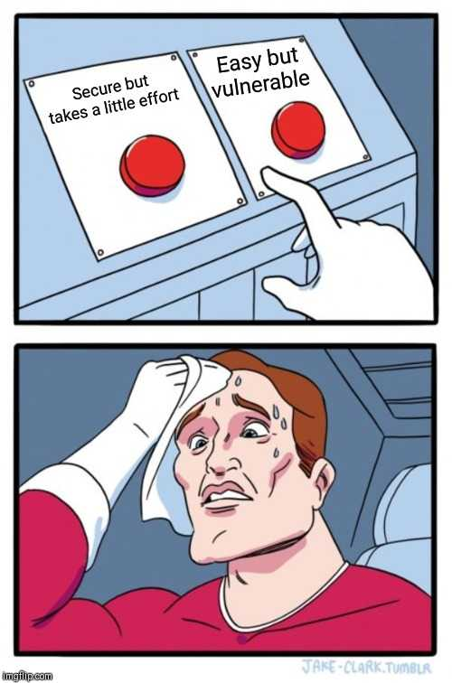
If you make the easy way the secure way
Developers will do whatever is simplest, which is secure
You will need less developer training
Training will be more effective
Security will not impede development
Notes:
Simple as possible to get it running
Hard to undo bad patterns
The default

Slide 8
Existing Examples

Slide 9
Example: Reducing XSS thanks to React
By Default: HTML will not encode user input by default
It relies on the developer to encode the user input
The app will ‘work’ without proper encoding
This leads to XSS
React/JSX makes it safe by default
By default it encodes
If you want to go unsafe, you have a scary name!
Result: developers usually do it the safe way
Notes:
Angular does it too!

Slide 10
Example: Eliminating the dangers of string concatenation
Dynamic SQL can end up with SQL injection
ORMs (Object relational mapper) removes the need for dynamic SQL
Result: Developers do it the safe way!
Set it to ‘alice OR 1=1’ and you’ll dump the whole DB!
The developers just wanted to query the database
And then they shoot themselves in the foot!

Slide 11
Example XXE in .Net
By default: XMLDocument uses document type definitions (DTD)
This lead to XML external entity attacks
To turn it off you had to set the ProhibitDtd property to true
From .Net 4.6 onward it was safe by default
If you really wanted, you can turn it back on
Result: developers do it the safe way
You can just read from the file system!
The developers just wanted to parse XML!
And then they shoot themselves in the foot!
Notes:
DTD = document type definitions

Slide 12
How to make the easy way the secure way!
A
B

Slide 13
How to make it easy
Find the bad pattern
Make the the safe pattern the default one
Train the developers to use the safe pattern
Build tools to enforce the new rules
Notes:
The Gist of what we are doing
Bad pattern
Make it safe by default

Slide 14
ReDoS: Regex Denial of Service
In some frameworks an inefficient regex can hold up a thread perpetually
The safe way is to ALWAYS wrap it in a timeout
Developers have to remember a timeout every time!

Slide 15
ReDoS: Make it safe by default
Create a wrapper class around regex
This gets technical
Do this once right so you don’t repeat yourself

Slide 16
ReDoS: Sample training
If you use the default regex class, a poorly crafted regular expression can result in executing with exponential time. Instead use the MySafeRegex class since this bounds the execution to a reasonable amount of time.

Slide 17
How to write training/documentation
If you use <THE BAD WAY>, <BAD THING WILL HAPPEN>. Instead use the <THE GOOD WAY> since <IT STOPS THE BAD THING>.
DO NOT DO THIS:
<EXAMPLE OF THE BAD WAY>
DO THIS INSTEAD:
<EXAMPLE OF THE GOOD WAY>
Explain it simply and clearly.
You do not need to use security lingo like XXE/ReDoS/XSS/RCE etc.
First show an example on how the developer intends to do it if you have one
Then show how they can do it correctly.
Make sure it is simple to do.
If you want, you can include more details and links to OWASP or another good resource.

Slide 18
When should you train developers?
When they get access to the repository
Once a year, retrain for their specific department
Notes:
Add image

Slide 19
ReDoS Code Analysis
Simple way
Use a regex to find where your developers are using the bad method:
I recommend using a tool like DevSkim, but you can use any code searching tool like grep
https://github.com/microsoft/DevSkim
Complex and more accurate way
Use a static analyzer to find all instances of the base regex class being used
Roslyn is a great tool for this. You can get the type of all objects and then show results for banned classes.
Notes:
Remember to explain DevSkim made by microsoft
Talk about blocking with these tools at the PR
How to convince devs:
Before they get git access
During PRs
Bad idea in the IDE

Slide 20
Example unsafe regex DevSkim rule
Clear description
Optional:
Link to documentation
Start with simple rules.
Go for 80%
Optional:
Have exclusions
Notes:
Format of the code {
"name": "Possible regex denial of service attack",
"id": "REDOS_1",
"description": "It is possible to perform a regex denial of service attack with the standard .Net regex library. ",
"recommendation": "Please use MySafeRegex class to generate this",
"applies_to": [
"csharp"
],
"severity": "important",
"patterns": [
{
"pattern": "new Regex\\(",
"type": "regex-word",
"scopes": [
"code"
]
}
],
"conditions": [
{
"pattern": {
"pattern": "new MySafeRegex\\(",
"type": "regex-word",
"scopes": [
"code"
]
},
"search_in": "finding-only",
"negate_finding": true
}
]
},

Slide 21
When to use this code analysis
In the IDE is great, but difficult to get adoption
Developers are open to feedback in pull requests before merge
The target is developers. Include it as part of your existing CI/CD pipeline
On your own cadence for your entire code base
The target is the security team. Schedule a regular cadence for this

Slide 22
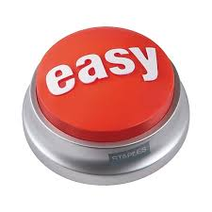
How we made it easy to stop ReDoS
Find the bad pattern
Make the the safe pattern the default one
Train the developers to use the safe pattern
Build tools to enforce the new rules
Notes:
The Gist of what we are doing
Bad pattern
Make it safe by default

Slide 23
XXE in Java: Bad Pattern and Safe Default
By default the SAXParser XML parser for Java allows DTDs
Create a wrapper factory
Wrap in your own class
Set to safe by default
SAXParser is just an example Java library, I am not picking on it for any particular reason.
This is explained for other Java libraries on: https://cheatsheetseries.owasp.org/cheatsheets/XML_External_Entity_Prevention_Cheat_Sheet.html accessed 07/29/2019

Slide 24
XXE in Java: Training
If you use the standard XML parsers like SAXParser, you may allow an attacker to remotely write files and control the server through the DTD. Instead use the MySafeXMLParserFactory since it blocks the attacker from setting DTD variables.

Slide 25
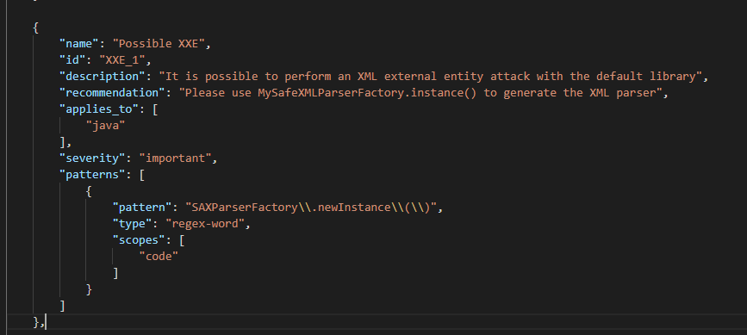
XXE in Java: Enforce the Rules
Notes:
Note that you didn’t need exceptions in this one

Slide 26
How we made it easy to stop XXE
Find the bad pattern
Make the the safe pattern the default one
Train the developers to use the safe pattern
Build tools to enforce the new rules
Notes:
The Gist of what we are doing
Bad pattern
Make it safe by default

Slide 27
Imagine you get an email like…
Hello!
We need you to log into your bank account to verify your information since we believe you may have been hacked.
Please go to https://somebigbank.com?redirect=http://evilphishingsite.com and type in your username and password to stop Mr. Robot!
We take your security very seriously!
Some Big Bank

Slide 28
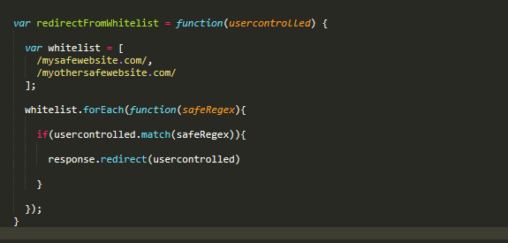
Dangers of Open Redirects
Open redirects can trick users into malicious phishing sites
If you don’t block the protocol, you can get XSS if the payload is: javascript:alert(1)
We often recommend people to use a whitelist
mysafewebsitexcom.evilwebsite.com
evilwebsite.com?foo=mysafewebsite.com
javascript:alert(‘mysafewebsite.com’)
Let’s play spot the bug!!!
Notes:
Mysafewebsitexcom.evilwebsite.com would match
evilwebsite.com?foo=mysafewebsitexcom would match

Slide 29
Redirect safely once and for all!
Make a Safe Redirect with:
An internal redirect method
Blocks all non-http(s) protocols
Only allows redirects to your specific site
An external redirect method
Blocks all non-http(s) protocols
Requires a whitelist as an argument
You can assume all internal redirects are safe
You can audit all uses of the external redirect to ensure it has a good whitelist

Slide 30
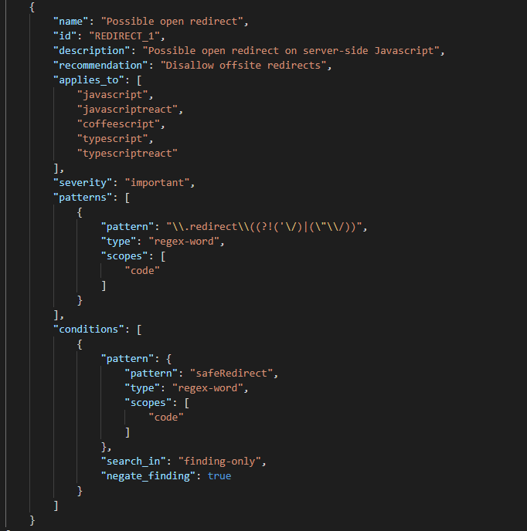
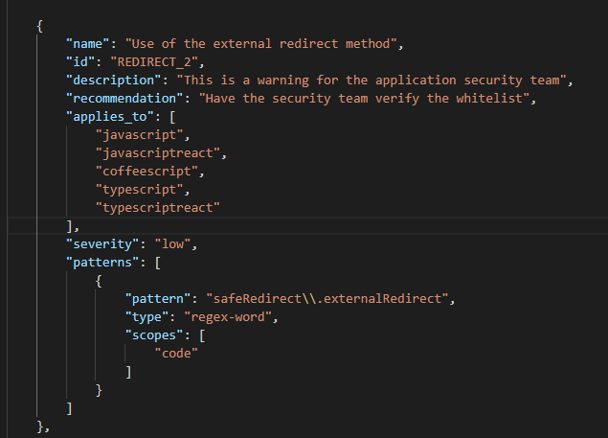
DevSkim Rules for Open Redirects
Aim for 80% on your rule
For ‘unsafe’ use cases

Slide 31
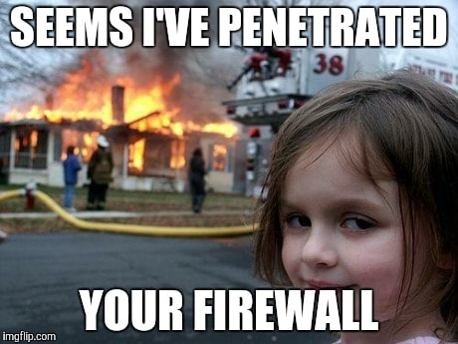
Dangers of Server Side Request Forgery
Vulnerable
Server
Directly calls another server
Bypasses the firewall
Hacker
Victim
Server
Blocked
Notes:
Removw file write

Slide 32
What could you do with server side request forgery in C#?
Get past the firewall by calling internal IP addresses
Call external servers with long responses
Do a file read file:\\\C:\path\to\file.txt
Do a file write to file:\\\C:\inetpub\wwwroot\default.html

Slide 33
Server Side Request Forgery
Sometimes an application must perform web calls (This is a feature)
You want to limit the damage of SSRFAAS (SSRF as a service)
Block internal IPs
Have a built in timeout for long running requests
Block calls to the file system (This can lead to LFI and RCE)
Set up a safe version that inherits all the features of your web client library

Slide 34
Recap

Slide 35
1. Find the bad pattern
ReDoS must reach a regular expression!
Look for a common ‘sink’ that a kind of bug has to reach
XXE requires that you parse XML!
Open redirects require a redirect!

Slide 36
2. Make the safe pattern the default one
Make a safe default wrapper class for the unsafe method
Have a coder do this once right

Slide 37
3. Train the developers to use the safe pattern
If you use <THE BAD WAY>, <BAD THING WILL HAPPEN>. Instead use the <THE GOOD WAY> since <IT STOPS THE BAD THING>.
DO NOT DO THIS:
<EXAMPLE OF THE BAD WAY>
DO THIS INSTEAD:
<EXAMPLE OF THE GOOD WAY>

Slide 38
4. Build tools to enforce the rules
Use simple regex to find the bad pattern with tools like DevSkim
Aim for 80% effective at first
Run at a regular cadence

Slide 39
Recap on how to do this
Make the easy way the secure way!
Find the bad pattern
Make the safe pattern the default one
Train the developers to use the safe pattern
Build tools to enforce the new rules
A
B

Slide 40
Thank you! morgan.roman@docusign.com

